Slide 1
HTML forms Part 1

Slide 2
HTML Form Tags
HTML website forms should be enclosed inside the FORM tags. There are various parameter options available, the most common ones are: action - this allows you to tell the form where to go once submitted (usually the filename of a script which will read and process the form data which has been submitted). name - it's usually a good idea to give your forms a name, this is used to uniquely identify your form on a given page. method - the value of this should be POST or GET. This tells the form how to send the data once submitted. Forms should usually always be set to use POST (as GET will attached the form data onto the page URL which is almost always a bad idea for security reasons). There are some other methods available, but we will not discuss these here.
<form action="index.php" name="myform" method="POST">
Example form field: <input type="text" name="example">
</form>
Example form field:

Slide 3
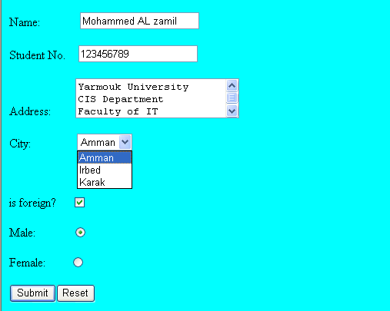
Form elements
<INPUT> Element’s Properties
TYPE= Type of INPUT entry field.
NAME = Variable name passed to CGI application
VALUE= The data associated with the variable name to be passed to the CGI application
SIZE= Number of visible characters in text field
MAXLENGHT= Maximum number of characters accepted.
Sami Ali
TYPE elements have values:
Text boxes,
Submit
Reset
Password boxes,
Checkboxes,
Radio buttons,
File,
Hidden
Mutah University

Slide 4

1- HTML Text Field - Single Line
Text boxes: Used to provide input fields for text, phone numbers, dates, etc.
<input type= "text " > Browser will display
Textboxes use the following attributes:
type: text.
size: determines the size of the textbox in characters. Default=20 characters.
maxlength : determines the maximum number of characters that the field will accept.
name: is the name of the variable to be sent to the CGI application.
value: will display its contents as the default value
<form action="index.php">
Enter your name: <input type="text" name="your_name“ >
</form>

Slide 5
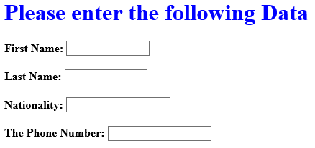
Example of Text Box
<TITLE>Form_Text_Type</TITLE>
<HEAD> <BODY>
<h1> <font color=blue>Please enter the following Data</font></h1>
<form name="form1" Method= " get " Action= " URL " >
First Name: <input type="text" name="FName" size="15" maxlength="25"><BR><BR>
Last Name: <input type="text" name="LName" size="15" maxlength="25"><BR><BR>
Nationality: <input type="text" name=="Country"size="15" maxlength="25"><BR><BR>
The Phone Number: <input type="text" name=NAME="Phone"size="15" maxlength="15"><BR>
</FORM> </BODY> </HTML>

Slide 6

2- HTML Submit button
Every form should probably allow the user to option of submitting the form. Again the button field is an input type field (as text and password fields are),.
To specify the text which appears on the button, we use the value parameter to state out value (in the example below we state 'Submit Form').
This is the element causes the browser to send the names and values of the other elements to the CGI Application specified by the ACTION attribute of the FORM element.
Submit has the following attributes:
TYPE: submit.
NAME: value used by the CGI script for processing.
VALUE: determines the text label on the button, usually Submit Query.
<form action="index.php">
<input type="submit" value="Submit Form" name="submit">
</form>

Slide 7
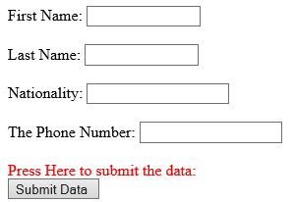
Submit Button Example
<FORM Action="url" method="get">
First Name: <input type="text" name="FName" size="15" maxlength="25"><BR><BR>
Last Name: <input type="text" name="LName" size="15" maxlength="25"><BR><BR>
Nationality: <input type="text" name="Country"size="15" maxlength="25"><BR><BR>
The Phone Number: <input type="text" name=NAME="Phone"size="15" maxlength="15">
<BR><br>
<font Color=red> Press Here to submit the data:<BR>
<input type="submit" value="Submit Data " >
</FORM>

Slide 8
3- HTML Password Field
If you ever need to ask your users to enter a password into a form, then you should use the special text field type password. Using this option will mask each character as the user types, allowing them to type in secret.
Password boxes use the following attributes:
Type: password.
Size: determines the size of the textbox in characters.
Maxlength: etermines the maximum size of the password in characters.
Name: is the name of the variable to be sent to the CGI application.
Value: is usually blank.
<form action="index.php">
Enter your password: <input type="password" name="password">
</form>

Slide 9
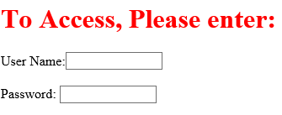
Example on Password Box
<html>
<head><title>Form_Password_Type</title><head>
<body>
<h1> <font color=red>To Access, Please enter:</font></h1>
<form name="frame2" Action="url" method="get">
User Name:<input type="text" name="FName" size="15" maxlength="25"> <BR><br>
Password: <input type="password" name="PWord" size="15" value="" maxlength="25"> <BR>
</form>
</body> </html>

Slide 10

4- HTML Reset button
Occasionally you may want to allow your visitors to reset a form back to its default state. As with the Submit button, you specify the button text using the value parameter.
It allows the surfer to clear all the input in the form.
<INPUT TYPE=“RESET”>
Reset buttons have the following attributes:
TYPE: reset.
VALUE: determines the text label on the button, usually Reset.
<form action="index.php" name="resettest">
Enter your name: <input type="text" name="your_name"><br />
<input type="reset" value="Reset Form" name="submit">
</form>

Slide 11
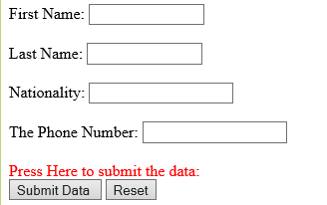
Reset Button Example
<FORM Action="url" method="get">
First Name: <input type="text" name="FName" size="15" maxlength="25"><BR><BR>
Last Name: <input type="text" name="LName" size="15" maxlength="25"><BR><BR>
Nationality: <input type="text" name="Country"size="15" maxlength="25"><BR><BR>
The Phone Number: <input type="text" name=NAME="Phone"size="15" maxlength="15">
<BR><br>
<font Color=red> Press Here to submit the data:<BR></font>
<input type="submit" value="Submit Data " >
<input type="reset" value="Reset">
</FORM>

Slide 12

5- HTML checkbox button
Check Box: Check boxes allow the users to select more than one option.
<INPUT TYPE="CHECKBOX"> Browser will display
Checkboxes have the following attributes:
TYPE: checkbox.
CHECKED: is blank or CHECKED as the initial status.
NAME: is the name of the variable to be sent to the CGI application.
VALUE: is usually set to a value.
<form action="url">
<b><u> Select you favorite fruit :- </u> </b>
<input type="checkbox" name="fruit" value="apples" > Apples<br>
<input type="checkbox" name="fruit" value="oranges"> Oranges<br>
<input type="checkbox" name="fruit" value="pears"> Pears<br>
</form>

Slide 13
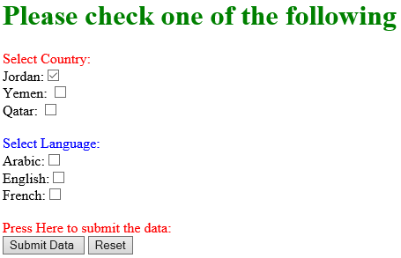
CheckBox Example
<HTML> <HEAD><TITLE>CheckBoxType</TITLE> </HEAD>
<BODY>
<h1> <font color=green>Please check one of the following</font></h1>
<FORM name="form3" Action= "a.php" method="get">
<font color=red> Select Country: </font><BR>
Jordan:<INPUT TYPE="CheckBox" Name="country" CHECKED><BR>
Yemen: <INPUT TYPE="CheckBox" Name="country"><BR>
Qatar: <INPUT TYPE="CheckBox" Name="country"><BR> <BR>
<font color=blue>Select Language:</font><BR>
Arabic:<INPUT TYPE="CheckBox" Name="language" ><BR>
English:<INPUT TYPE="CheckBox" Name="language"><BR>
French:<INPUT TYPE="CheckBox" Name="language"> <BR> <BR>
<font Color=red> Press Here to submit the data:<BR></font>
<input type="submit" value="Submit Data " >
<input type="reset" value="Reset">
</FORM> </BODY></HTML>

Slide 14

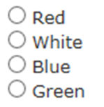
6- HTML Radio Buttons
Radio Button: Radio buttons allow the users to select only one option.
<INPUT TYPE=“RADIO”> Browser will display
Radio buttons have the following attributes:
TYPE: radio.
CHECKED: is blank or CHECKED as the initial status. Only one radio button can be checked
NAME: is the name of the variable to be sent to the CGI application.
VALUE: usually has a set value.
<form action="index.php">
<input type="radio" name="color" value="red" > Red<br >
<input type="radio" name="color" value="white" > White<br >
<input type="radio" name="color" value="blue" > Blue<br >
<input type="radio" name="color" value="green" > Green<br >
</form>

Slide 15
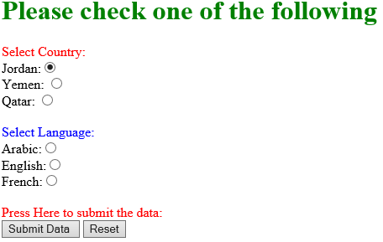
Radio Example
<HTML> <HEAD><TITLE>CheckBoxType</TITLE> </HEAD>
<BODY>
<h1> <font color=green>Please check one of the following</font></h1>
<FORM name="form3" Action= "a.php" method="get">
<font color=red> Select Country: </font><BR>
Jordan:<INPUT TYPE=“radio" Name="country" CHECKED><BR>
Yemen: <INPUT TYPE="CheckBox" Name="country"><BR>
Qatar: <INPUT TYPE="CheckBox" Name="country"><BR> <BR>
<font color=blue>Select Language:</font><BR>
Arabic:<INPUT TYPE="CheckBox" Name="language" ><BR>
English:<INPUT TYPE="CheckBox" Name="language"><BR>
French:<INPUT TYPE="CheckBox" Name="language"> <BR> <BR>
<font Color=red> Press Here to submit the data:<BR></font>
<input type="submit" value="Submit Data " >
<input type="reset" value="Reset">
</FORM> </BODY></HTML>

Slide 16

7- HTML File Upload Field (field selector)
Sometimes it may be good to offer your website users the option to upload a file. For this you could use the HTML field type file. If you are using this option you also need to include an additional option to the FORM tag enctype="multipart/form-data“
<form action="index.php" enctype="multipart/form-data">
Select a file to upload: <input type="file" name="selectedfile" />
</form>

Slide 17
8- HTML Hidden Field
Hidden: Used to send data to the CGI application that you don’t want the web surfer to see, change data
<INPUT TYPE=“HIDDEN”> Nothing is displayed in the browser.
Hidden inputs have the following attributes:
TYPE: hidden.
NAME: is the name of the variable to be sent to the CGI application.
VALUE: is usually set a value expected by the CGI application.
<input type="hidden"
name="hidden1"
value="Form example for demo" />

Slide 18
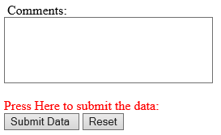
HTML Textarea (multiple lines text field )
The multi-line text field (commonly known as a textarea field) is more suitable to take larger block of text from your visitors. This is idea for comments.
<form action="index.php">
Comments: <BR> <textarea rows="5" cols="30"> </textarea>
<font Color=red> Press Here to submit the data:<BR></font>
<input type="submit" value="Submit Data " >
<input type="reset" value="Reset">
</form>

Slide 19

HTML drop-downs (aka selects or combo-boxes)
When you want your visitors to pick something from a list, you could use a drop-down list. These are sometimes know as option selects, select fields or combo-boxes. By default only one option can be selected, however you can allow multiple selections by including the word multiple to your select tag (this will also alter the appearance of the field).
<form action="index.php">
Select Something:
<select name="something">
<option value="Google"> Google </option>
<option value="Bing"> Bing </option>
<option value="Yahoo"> Yahoo </opton>
</select>
</form>
Attribute | Value | Description
form | form_id | Defines which form the drop-down list belongs to
multiple | multiple | Specifies that multiple options can be selected at once
name | name | Defines a name for the drop-down list
required | required | Specifies that the user is required to select a value before submitting the form
size | number | Defines the number of visible options in a drop-down list

Slide 20

combo-boxes Example
<font color=blue>Select Language:</font><BR>
<form>
<select name="language" >
<option value="Arabic">Arabic</option>
<option value="English">English</option>
<option value="Spanish">Spanish</option>
<option value="French">French</option>
</select>
</form>

Slide 21
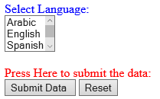
combo-boxes Example
<font color=blue>Select Language:</font><BR>
<form>
<select name="language" size="3" required="required" >
<option value="Arabic">Arabic</option>
<option value="English">English</option>
<option value="Spanish">Spanish</option>
<option value="Frinsh">Frinsh</option>
</select>
<br><br>
<font Color=red> Press Here to submit the data:<BR></font>
<input type="submit" value="Submit Data " >
<input type="reset" value="Reset">
</form>

